Slide 1
GFPD DDACTS Launch Community Survey
Monday, August 01, 2016

Slide 2
389
Total Responses
Date Created: Monday, May 09, 2016
Complete Responses: 389

Slide 3
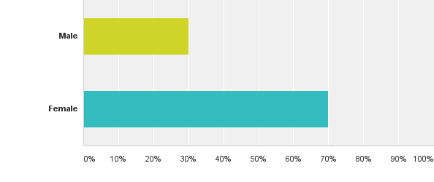
Q2: What is your gender?
Answered: 389 Skipped: 0
% of Number of
Total response Responses
30.08% 117
69.92% 272

Slide 4
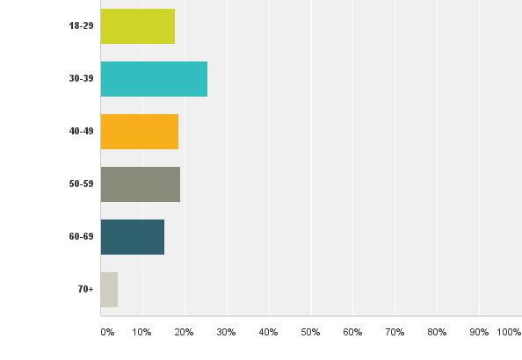
Q3: What is your age range?
% of Number of
Total response Responses
Answered: 389 Skipped: 0
17.74% 69
25.45% 99
18.51% 72
19.02% 74
15.17% 59
4.11% 16

Slide 5
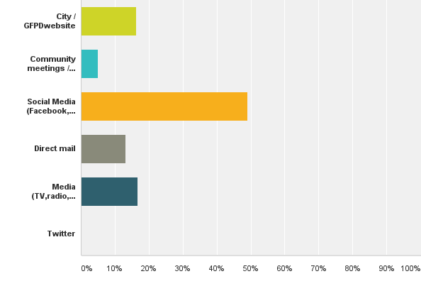
Q4: What is your preferred way of receiving information from the Great Falls Police Department?
% of Number of
Total response Responses
Answered: 383 Skipped: 6
16.19% 62
4.96% 19
49.09% 188
13.05% 50
16.71% 64
0.00% 0

Slide 6
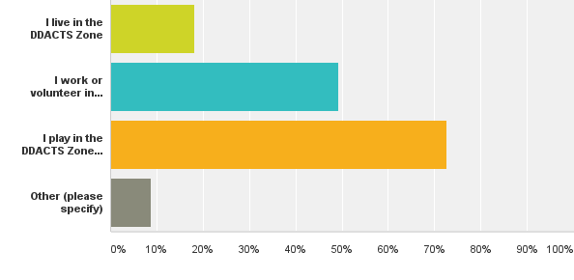
Q5: What do you do in the DDACTS Zone? Choose all that apply(Park Dr to 15th St and 6th Ave N to 6th Ave S)
Answered: 385 Skipped: 4
% of Number of
Total response Responses
18.18% 70
49.35% 190
72.73% 280
8.83% 34

Slide 7
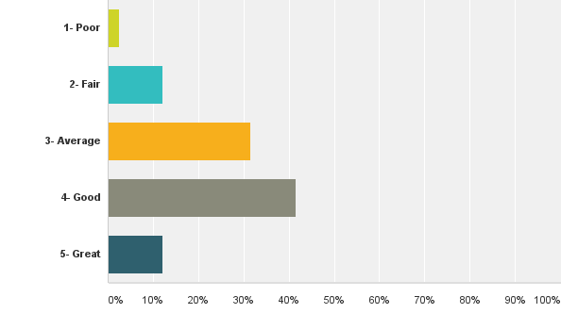
Q6: Please rate your quality of life in the DDACTS zone
Answered: 385 Skipped: 4
% of Number of
Total response Responses
2.60% 10
12.21% 47
31.43% 121
41.56% 160
12.21% 47

Slide 8
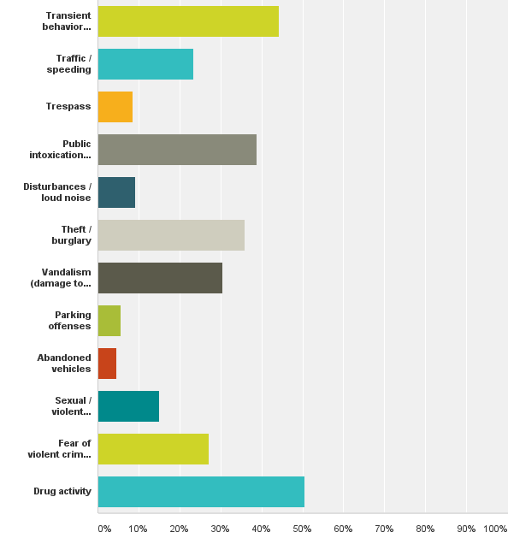
Q7: Please select your top three(3) safety/crime concerns in the DDACTS Zone
% of Number of
Total response Responses
Answered: 384 Skipped: 5
44.27% 170
23.44% 90
8.59% 33
38.80% 149
9.11% 35
35.94% 138
30.47% 117
5.73% 22
4.69% 18
15.10% 58
27.08% 104
50.52% 194

Slide 9
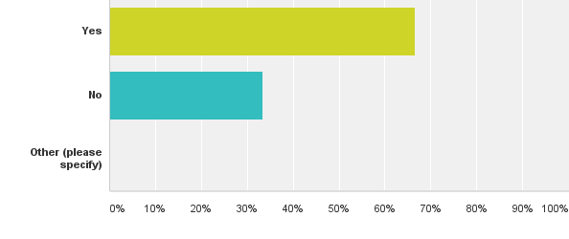
Q9: Since May 1, 2016 - Have you noticed added police presence in the area?
Answered: 383 Skipped: 6
% of Number of
Total response Responses
66.58% 255
33.42% 128
Total: 383

Slide 10
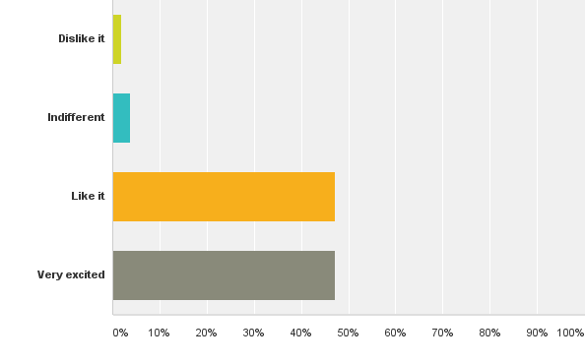
Q10: What is your general opinion about the added police presence?
Answered: 261 Skipped: 128
% of Number of
Total response Responses
1.92% 5
3.83% 10
47.13% 123
47.13% 123

Slide 11
Our Survey winners!
Janis McGregor- $150
Jamie Brown- $50
Carl Thrasher- $50

Slide 12
Overview
I would encourage everyone to page through the responses to question # 8 which was:
“Please provide any other information you would like us to consider”
Most of the survey participants we got were from the Coffee With a Cop at the farmers market and from volunteers hitting the pavement and soliciting participants at businesses.

